Slide 1
Ada and BNF

Slide 2
Recommended Reading
Ada
Section 2.14 – History’s Largest Design Effort: Ada
Section 6.14 – Type Equivalence
BNF
Section 3.3 – Formal Methods of Describing Syntax

Slide 3
Ada
The tale of that one time the DOD built a programming language

Slide 4
The Software Crisis of the 1970s
The 1970s saw the “Software Crisis”. Costs of programming were increasing exponentially
Program development times were increasing in line with cost.
Complex software was basically impossible without some better way of writing it.
The private sector weren’t the only people in trouble, the US DoD was spending over 3 billion USD a year on software for embedded and mission critical hardware.
At the time, there were over 400 languages and dialects the US military used for software development.
The DoD wanted one master language to fix all these problems at once.

Slide 5
The DoD Higher Order Working Group
The DoD started the HOWG in 1975 to develop a single language for all their applications, without re-making the mistake of PL/1
The language needed to support:
Modularisation (Code reuse was extremely important)
Information Hiding (Security was, of course, paramount)
Concurrent processing (Mission critical processes need to happen in parallel)
Handling exceptional conditions (Planes should not fall out of the sky if the computer gets knocked around)
A simple means of checking program correctness

Slide 6
DoD HOWG Language Development
The HOWG studied 26 existing programming languages, determining their faults and strengths, and what was required in a new language.
Then, they opened a contest for private industry. The languages would be pitted against eachother, and the winner would become the new DoD master language. This is much the same sort of contest that decided which encryption scheme would become AES.
In the end, the language developed by the C2-Honeywell-Bull team was the victor in 1975, a highly modular, extraordinarily resilient language.
The language was named Ada, in honour of Augusta Ada King-Noel, Countess of Lovelace.

Slide 7
Who is Ada Lovelace?
A quick aside on ancient computer history

Slide 8

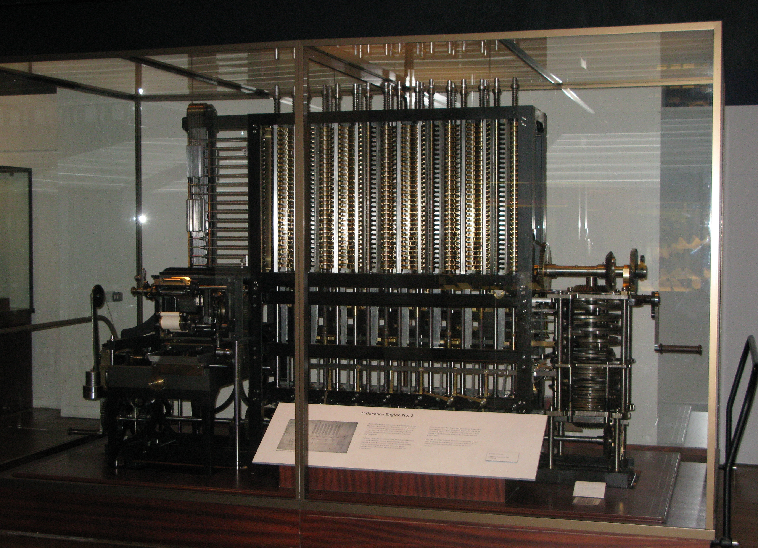
Meanwhile, in the 19th century
The year was 1822, and Charles Babbage, mad Victorian era polymath and engineer, was working on a device to automatically compute values of polynomial functions
The Difference Engine, pictured, was entirely mechanical, and was little more than an advanced calculator. However, the Difference Engine was not the end of Babbage’s project…

Slide 9
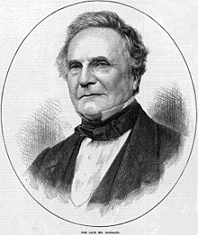
The Analytical Engine
Babbage had an idea to build a calculator that could perform any computation.
Still completely mechanical, but programmed by a form of punched card.
He never finished it, it was never made, and he never wrote any programs for it.

Slide 10
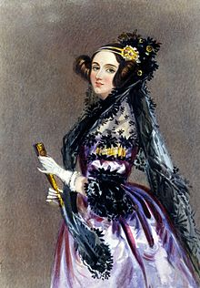
Lady Ada Lovelace
Lady Lovelace spent her life studying the sciences of the day, she was particularly fond of math.
She met Babbage during his lecturing in Italy
Lady Ada was fascinated by the capabilities of the Analytical Engine, and wrote the first programs for it as her own scientific work.
She was the first programmer.

Slide 11
Ada, again
Enough history, back to the 1970’s

Slide 12
Ada, the Language
Ada managed to invent the fantastic modularity of code we all love today.
Ada is standardized and there is only ever one Ada.
It is fantastically complex, with 331 pages of BNF as opposed to ALGOL-60’s 15 pages.
That said, the bulkiness of the language is considered to be entirely valuable.
Based on Pascal, strongly typed
Compilers are subject to conformity tests (ACATS) to be ‘certified’
As a result, the first compiler wasn’t available till 1980. A whole 5 years after the language’s development.
The language was updated for modernity in 1995, with new Object Oriented additions.

Slide 13
Ada at a Glance
Contributions
Packages
Exception Handling
Generic procedures
Concurrency
Built for reliability and re-use
Very large, complex

Slide 14
Modularity in Ada
The traditional method of controlling the complexity of a large program is through the use of modularisation
Each module is a small program in itself and can be implemented independently of other modules.
The work to implement a large program is roughly equivalent to the sum of the work required to implement all the modules
The cost and time is therefore roughly linear.
Modularity offers some advantages:
Reuse of code is increased (libraries of modules)
Allows information hiding (independence from eachother)
Each module can be debugged and maintained in isolation.

Slide 15
Information Hiding in Ada
The general idea is that each difficult decision should be hidden inside a module.
A user of a module does not need to know how the module is implemented and should not be able to write programs that depend on the module’s implementation.
The implementers don’t need to know the context in which the module will be used
When a programmer modularises a program, they need to hide both the algorithm and data structures used in the module.

Slide 16
More information hiding
Procedural Abstraction: Hiding the algorithm stops the user from seeing the instructions used in the module.
The subprograms in a modular language inherently hide these instructions.
Eg, a sorting module. You don’t know which sort is used. Just that unsorted stuff is sorted on the other end.

Slide 17
Even more information hiding
Data Abstraction: The user doesn’t know how data is stored in the module.
This prevents users from being able to guess the memory location of critical data and being able to interfere with it.
Example, a queue module. Is it an array? Linked list? You don’t know. You just know there’s a queue in there.

Slide 18
The Abstract Data Type
Encapsulating data abstraction with all the procedures that such data structures need results in an Abstract Data Type.
You don’t know how it’s represented in memory
You don’t know how it performs operations
You just know what it is, and how to use it.
The ADT is, for all intents and purposes, a class.
An instance of an ADT is, indeed, an object

Slide 19
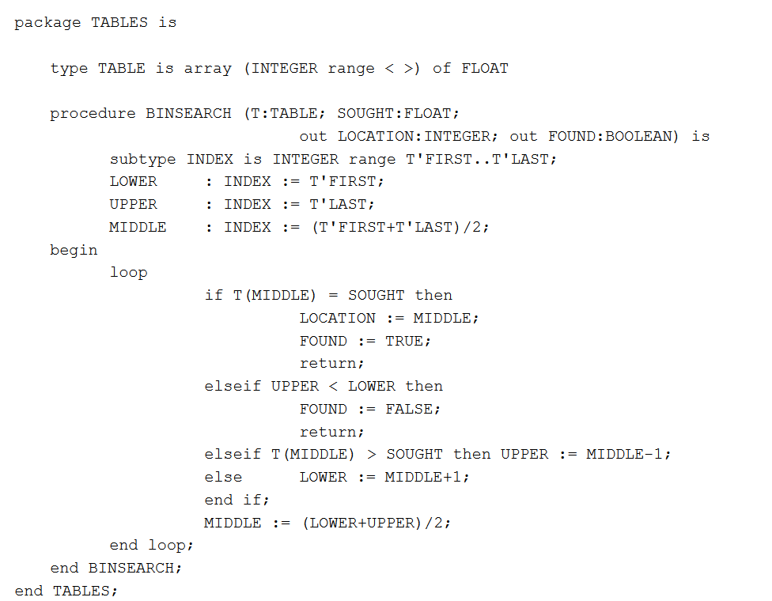
An Example Ada Package

Slide 20
Ada Program Structure
Since it was based on Pascal, it does appear pretty similar
Ada uses a convention that all keywords are lower case while all other words are uppercase.
Ada has four kinds of construct:
Declarations
Expressions
Statements
Types
Expressions and Statements are similar to Pascal
Types are improved versions of Pascal.

Slide 21
More Ada Program Structure
The type system in Ada is entirely strong name equivalency.
However, Ada introduces subtypes, and derived types.
These types are not the same as the base type, but allow the same operations.

Slide 22
Ada Enums
Ada has enumerated fields, but for the first time they can be overloaded
Eg:
type ONE is (RED, GREEN, BLUE)
type TWO is (RED, YELLOW, PINK)
RED is now ambiguous, could be type ONE or TWO.
Name equivalency solves this problem, so it’s okay!

Slide 23
Ada declarations
Ada has the following declarations:
Constant
Variable
Procedure
Function
These are all stolen from Pascal, and then improved upon.
Variable declarations actually allow you to initialise the variable. So many programs were brought down by using uninitialized variables before Ada.

Slide 24
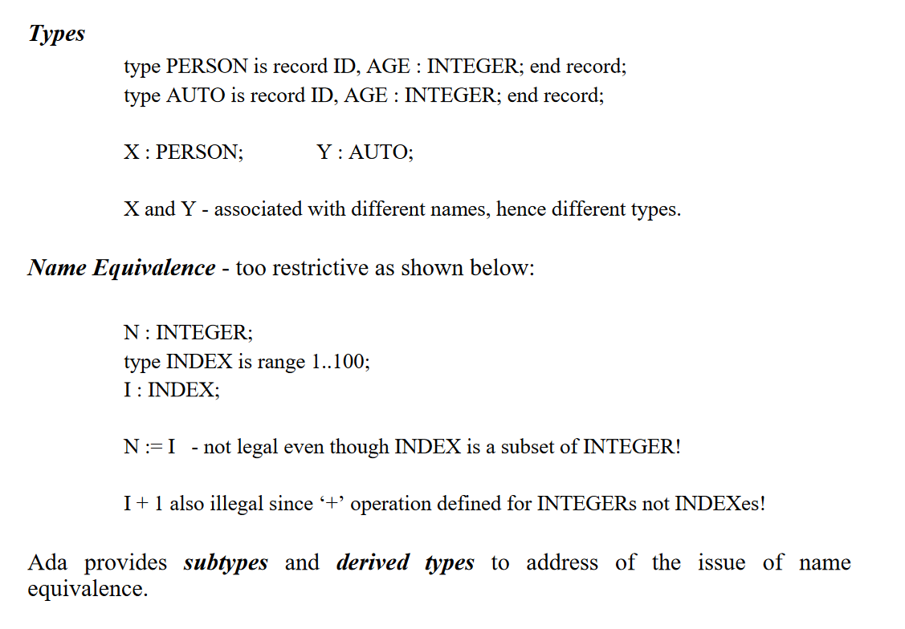
Where Name Equivalency Fails

Slide 25
Ada Syntax
Ada syntax goes some way to correct the errors of the previous three generations of languages
Syntax is highly regular and self explanatory
Ada is fully bracketed, each construct has it’s own bracket type (loop… end loop, if…. end if)
Unlike ALGOL-60 and Pascal which may or may not use a semicolon to end a line, Ada enforces a terminating semicolon, revealing itself as the true mother of C-like Languages.
This allows the compiler to do better error checking because it knows where it needs to find a line end.

Slide 26
Ada Control Structures
Ada introduces declarations for Packages and Tasks.
More control structures than Pascal.
Conditional (if) statement
General Iterator (loop) statement
Case statement
Legacy statements (Goto)
Ada also allows exception structures, and concurrency. In 1975!

Slide 27
The Great And Powerful Loop
Ada has exactly one iterator, the loop.
Can be a definite (for), indefinite (while), or infinite (???) loop.
Can be terminated using “exit”
Allows for an unlimited number of exit statements inside the loop under the term exit-when.

Slide 28
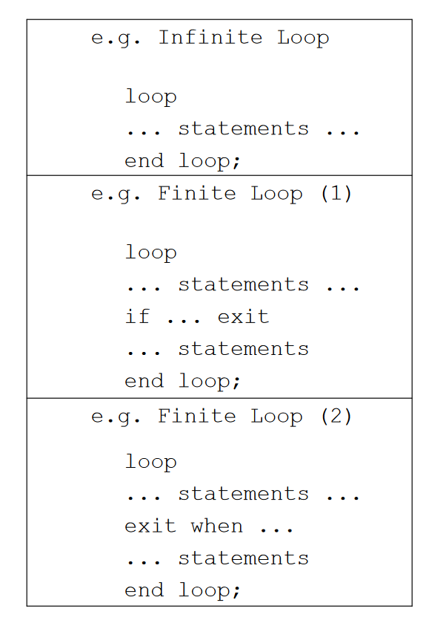
Getting Loopy

Slide 29
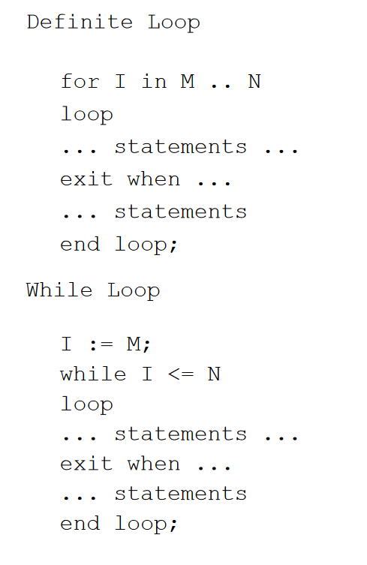
Loopier and Loopier

Slide 30
Looks like we forgot some more Ada Program Structure
Ada uses operator overloading, something used extensively today
Built in operators like +,-,*,/… and so on, can be redefined for user types.
function +(X, Y : COMPLEX) return COMPLEX;
The two most important facilities of Ada are:
The Package
The Task
Both declare modules
The Task is special though, we’ll get back to those later.

Slide 31
Module Structure
Each module forms a disjoint environment that can communicate with other modules through well-defined interfaces
This should sound exactly like OO, because it’s what OO was based on.
Each module is broken down into two parts:
The specification part: describing the interface to the module, and the procedures and types accessible.
The definition part: describes how it is implemented.

Slide 32
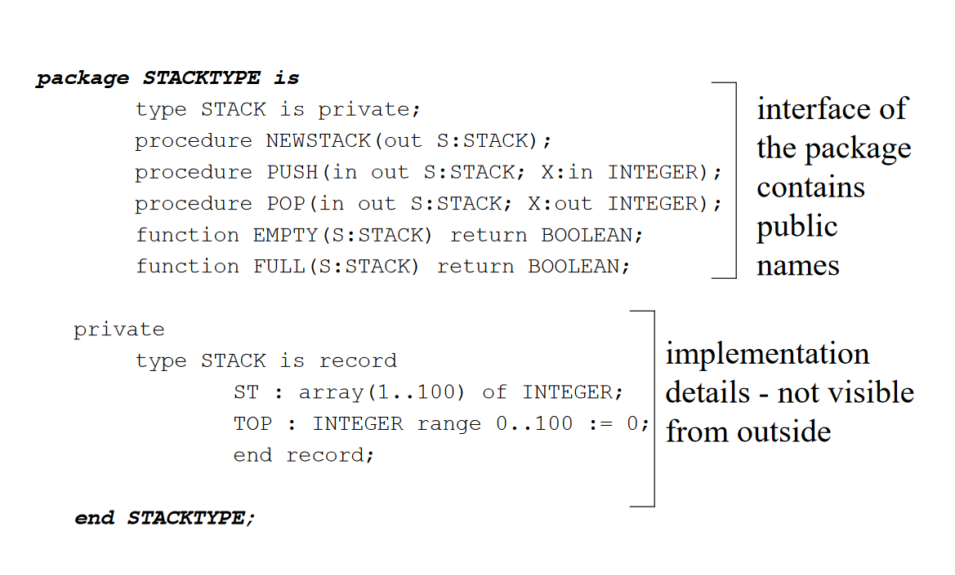
Package Example

Slide 33
Even More Program Structure
The Package and The Task support information hiding.
Packages can be used as:
Libraries (only procedures, no data structures)
Shared Data Areas (data structures but no procedures)
Data Structure Managers (full ADTs, like stacks or queues)

Slide 34
Parameter Passing
Review, and Ada’s new techniques

Slide 35
Parameter Passing Techiques
The most common ones you’ll see are pass-by-value and pass-by-reference.
Pass-by-value is great, it doesn’t cause side effects
Pass-by-reference is great, it is super memory efficient
Both of them suck, PbV is slow and inefficient while PbR causes so many problems via side effects.
Ada provides the best methods as it specifically allows the programmer to decide what access is allowed to the parameter without being clunky.

Slide 36
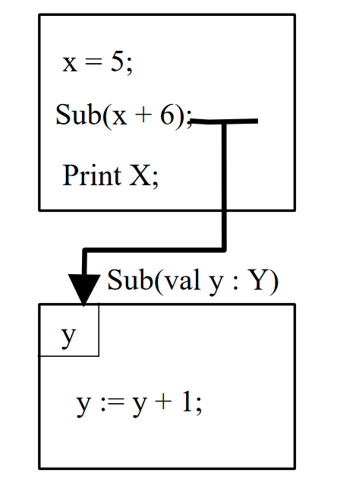
How to pass-by-value
Value of the parameter is copied.
Y is given the value of x+6
Which is 11.
When X is printed… you still get 5.

Slide 37
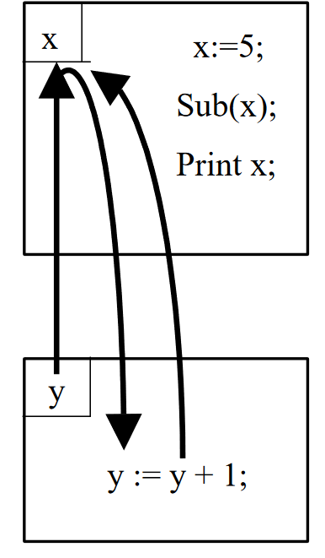
How to pass-by-reference
Y is now a reference to x.
Before the sub is called, x is 5.
Y, which is a reference to x, then adds one to itself… which means 1 is added to the value at the memory address of x… making x 6
So when it is printed back in the original program, x is 6.

Slide 38
Even Better: Pass By Result
Ada cares not for your old passing methods, it brings brand new ones that make things even better!
Call by Result lets Ada implement “out mode” parameters.
Formal parameter acts as an uninitialized local variable, which is given a value during execution
On leaving the procedure, the value of the formal parameter is assigned to the actual parameter.
Basically like a one way reference!

Slide 39
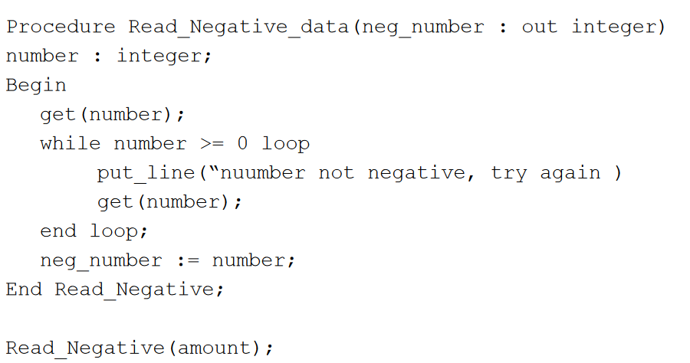
Pass By Result Gets Results!

Slide 40
Pass by Constant!
This one is easy
Read Only Pass by Value or Pass by Reference.
Doesn’t matter which, because any attempt to assign to the variable is illegal.
It’s actually left up to the compiler to decide which one to use.

Slide 41
Pass By Value-Result. Will wonders never cease?
Ada can go even further! Pass by Value-Result!
So, first up, the formal parameter is set as a local variable, it’s just set to a copy of the value of the actual parameter.
Then, changes to that parameter only happen to the local copy.
When the procedure completes, the final value of the formal parameter is sent to the actual parameter!
Might sound insane, but it’s actually still in use. C# considers this fundamental to thread management!

Slide 42
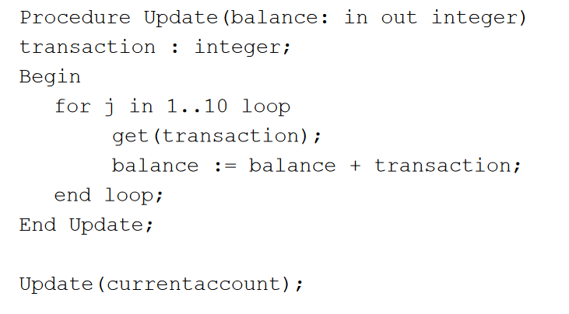
Pass By Value-Result Example

Slide 43
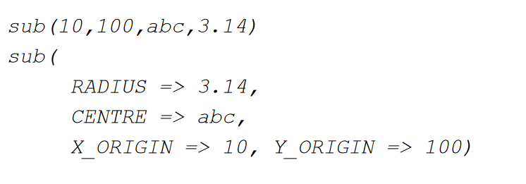
Position independent Params
Parameters can be listed in any order
This conforms with the labelling principle.

Slide 44
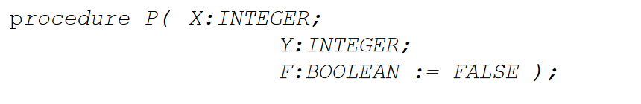
Default Parameters
Ada also permits the designer of a subprogram to specify the default parameter values if the actual values are omitted
This again, is used by many modern languages.

Slide 45
Global Variables
More interesting things Ada helps fix

Slide 46
Global Variable Problems
Global variables, as many of you know, are problematic at the best of times.
In the early 70’s, the block structure had got people thinking about the problems of scope creep and global variables.
Wulf and Shaw in 1973 identified four major problems:
Side Effects
Indiscriminate Access
Vulnerability
No Overlapping Definitions
Let’s have a look at these, and how Ada tries to solve them.

Slide 47
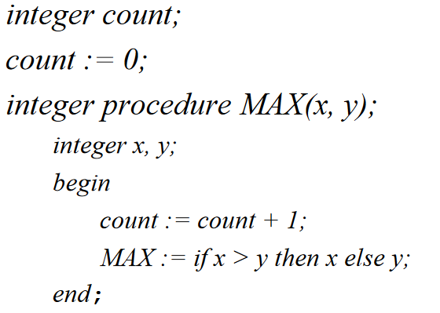
The Side Effect Problem
Side effects are when a non-local variable is changed by a subprogram
This is due to hidden access to that variable
Procedure computes the max, however...
Count is updated too!
Furthermore, if:
Length := Max(count,10)
Max modifies one of it’s own parameters! Aargh!
This can cause wide ranging problems that aren’t immediately noticeable.

Slide 48
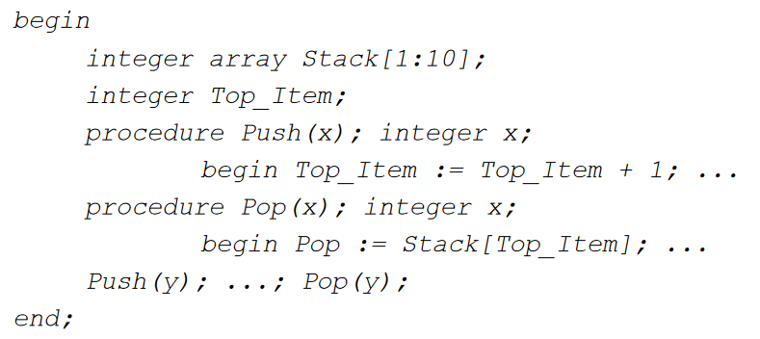
The Indiscriminate Access Problem
Programmers have no way to prevent inadvertent access to a variable.
Stack is visible to push and pop, as well as the users of Push and Pop.
The users can arbitrarily change the values of the Stack!
Can’t use an ADT in Pascal, because you need to be in the same block to begin with.
You can “play nice” and just use the interface, but that doesn’t actually stop anyone.

Slide 49
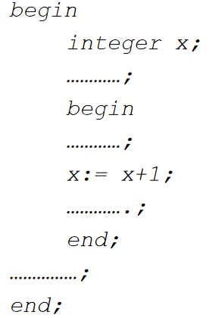
The Vulnerability Problem
Nobody has any real way to preserve access to variables either.
Example code increments some variable x
Our intern goes in and needs an iterator somewhere, so also calls it x (common mistake)

Slide 50
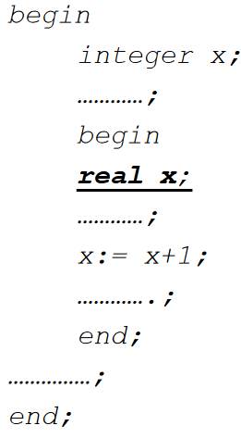
The Vulnerability Problem
Oh no!
Now we’ve incremented the wrong x!
Nothing you can do to say “use the global x”

Slide 51
The Overlapping Definitions Problem
If subprogram A is talking to subprogram B over one data area, and with subprogram C over another data area…
By definition, C must be able to see B’s data area.
There is no way to partition subprogram memory. If B can see some of A’s memory, it can see all of A’s memory, which must contain that bit of C’s memory too.
Everything is public all the time!
You cannot control shared access to variables!

Slide 52
Solutions!
Wulf and Shaw described four features that would solve the problems of global variables in blocks:
No implicit inheritance, name access must be explicit
Ada achieves this with modularisation.
Name access should be by mutual consent, both creator and accessor
Ada’s modular interfaces prevent non-consenting memory contact
Access to structures and substructures should be decoupled
Again, Ada’s information hiding modularity defines that no access implies any other access, implementing this.
Should be able to distinguish different access types, ie read only, read-write, etc…
Ada achieves this with Pass-by-Constant, Pass-By-Result, and Pass-By-Value-Result. You have integral security!

Slide 53
Generic Packages
Another addition Ada brings to the table

Slide 54
Generic Packages
One of the most powerful concepts in modern programming is the Generic.
Generics allow you to define a data type based on a completely separate user defined data type.
C++ is quite fond of this, you can have Queues, but queue<int>, queue<char>, queue,<queue<int>>… all different.
Ada was the first language to feature Generics.
A package defines a data structure with local processes and memory possessing a well defined interface
A generic package defines a name for a template which can be instantiated for many separate data structures

Slide 55
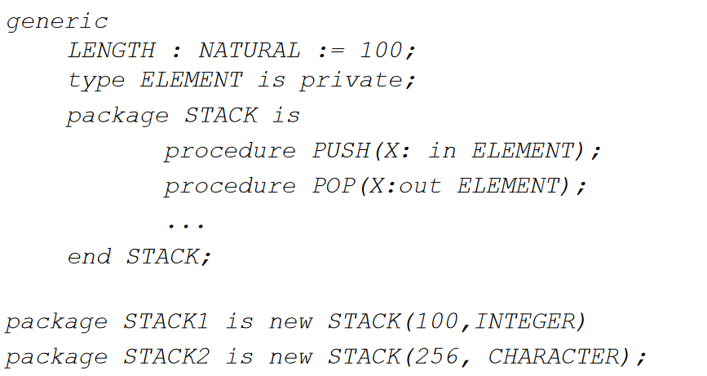
Generic Package Example

Slide 56
The Task and Concurrency
Did you need to worry about threads in 1975? Ada did.

Slide 57
The Task
Ada has, as we said earlier, two major declaration types:
Packages, which we’ve talked about until now
And Tasks.
Both consist of two parts, Specifications, and Declarations.
However, while packages can be libraries, data areas, data structure managers, even generics…
The Task declares a module that can be executed concurrently.

Slide 58
Task, simple example
You have a word processor.
It has two tasks:
Task for Editing
Task for Printing
Why? Because you can edit and print at the same time!
So they need to be concurrent.

Slide 59
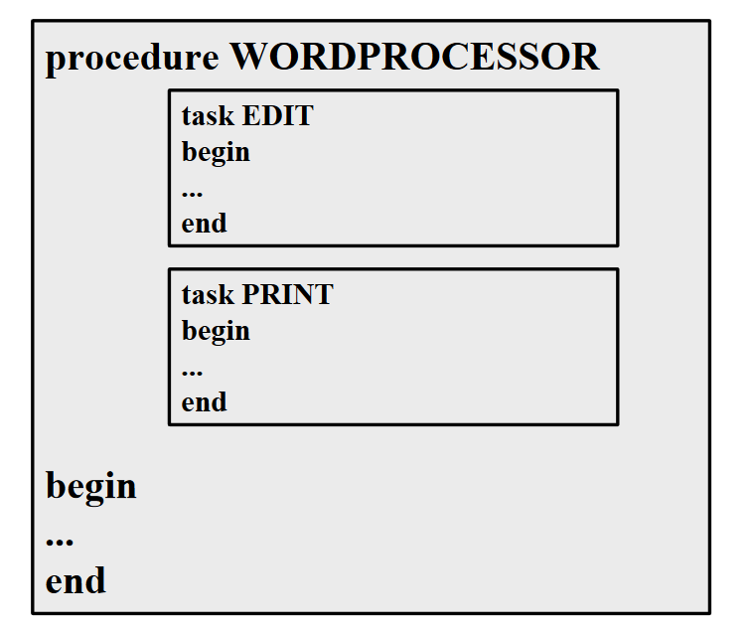
What that looks like

Slide 60
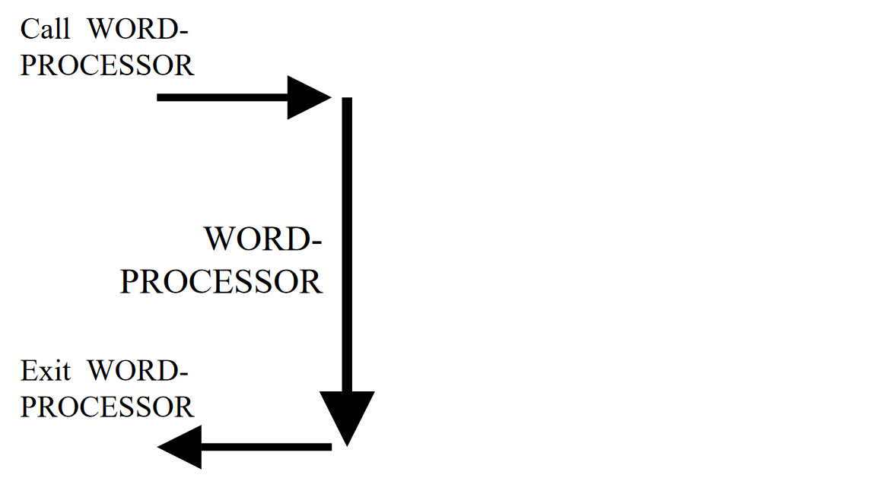
So…

Slide 61
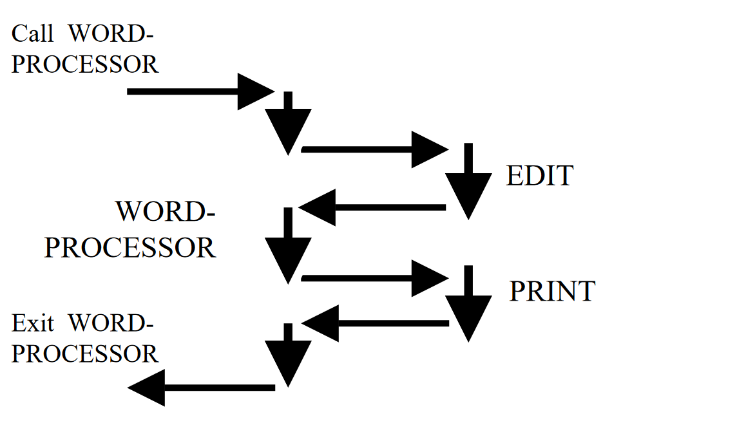
So… This is what you may think

Slide 62
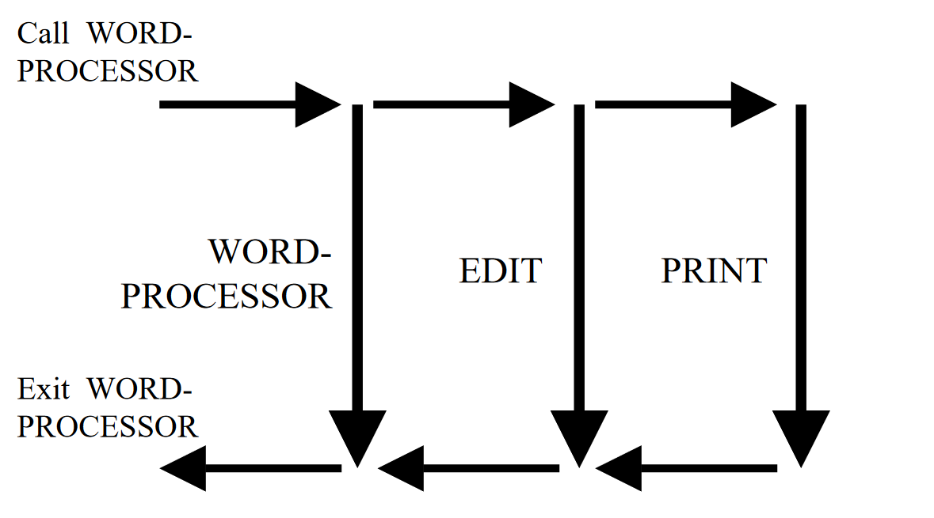
So… This is what Ada does

Slide 63
Multithreading on a single CPU
“But wait,” you may say, “Computers back then didn’t have many CPU cores that could use multithreading!”
This isn’t actually true, CRAY supercomputers had multiple cores… But that’s not the point
Python to this day only uses one thread context (see: GIL)
Still supports multithreading!
Concurrency can work with one CPU due to context switching.
Still have all the same pros and cons!

Slide 64
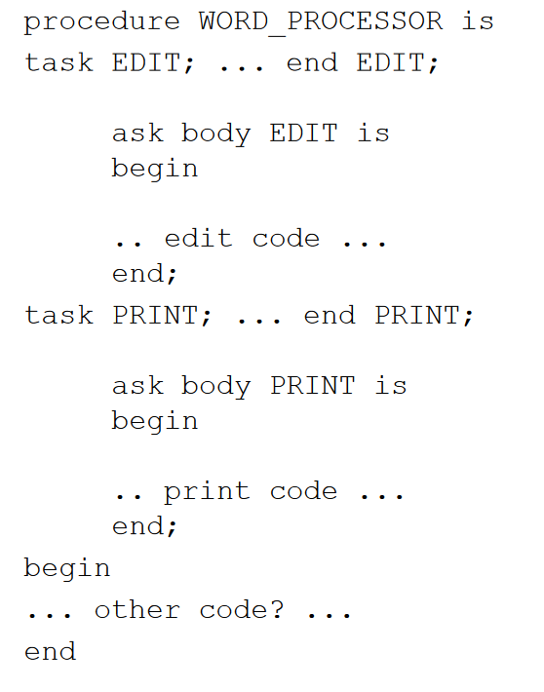
Tasks, more examples

Slide 65
Tasks and their similarity to thread contexts
When does a procedure return?
When the main procedure completes? Nope
When it executes the tasks? Nope
When everything is completed? Yep!
Tasks implicitly “join” the main thread of execution before the procedure returns.
This is because tasks need the environment of the initiating procedure to execute.
However, they do execute in parallel.
Tasks communicate via the “rendezvous” method.
This is an exchange of methods.
For it to work, both tasks must be in agreement.
The sender has to be trying to send, and the receiver has to be trying to receive at the same time…. Or they will wait forever in a Deadlock

Slide 66
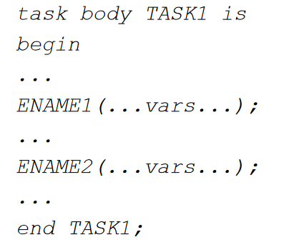
Sending a message
Sending task:
Calls entry procedure
Parameters are passed
Execution continues
Syntax →

Slide 67
Receiving a message
The receiving task:
Declares the entry procedures
Accepts entry procedures
Receives messages in parameters.
task TASK2; entry ENAME1(…fvars…); entry ENAME2(…fvars…); end TASK2; task TASK2 body is begin … accept ENAME1(…fvars…) do … end ENAME1; … accept ENAME2(…fvars…) do … end ENAME2; … end;

Slide 68
Rendezvous-ing
Task Rendezvous:
Accepting task blocks until it receives a message from another task
Sending task blocks until message it sends is accepted by another task.
The message will only ever be transmitted if the entry to which both the sender calls and the receiver accepts is the same!
A rendezvous can “miss”, and never take place
Unlike sane people, tasks may wait forever in a deadlock

Slide 69
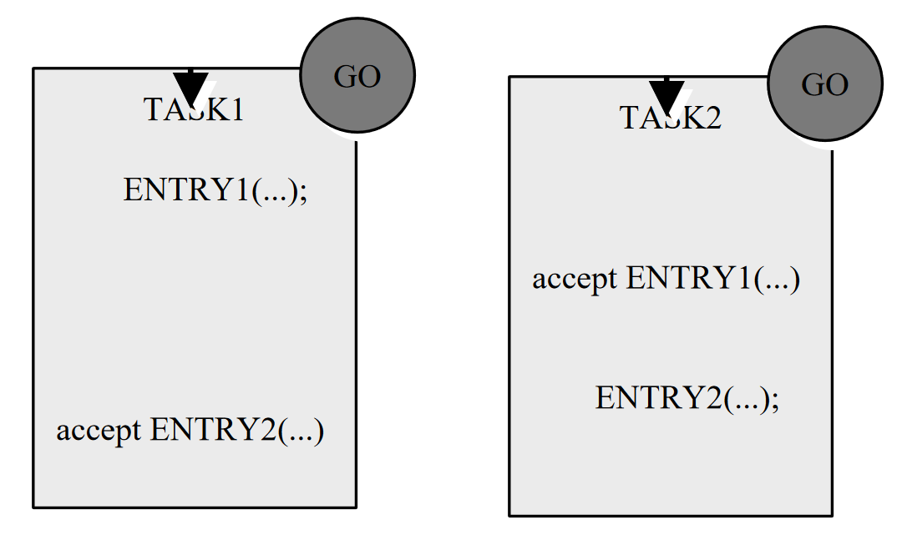
Task Rendezvous

Slide 70
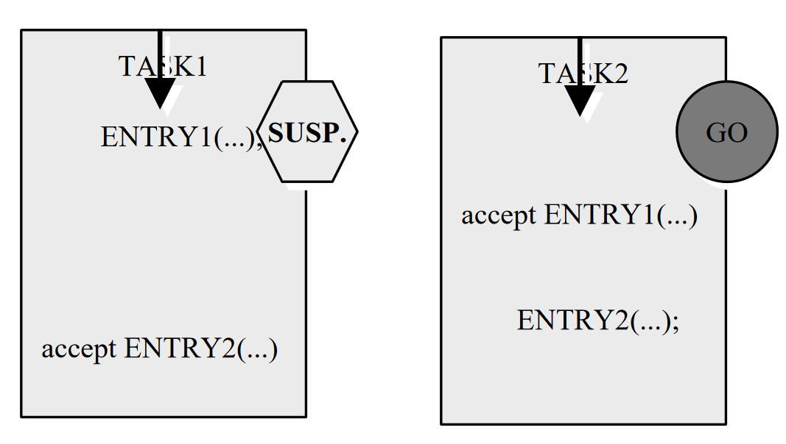

Slide 71
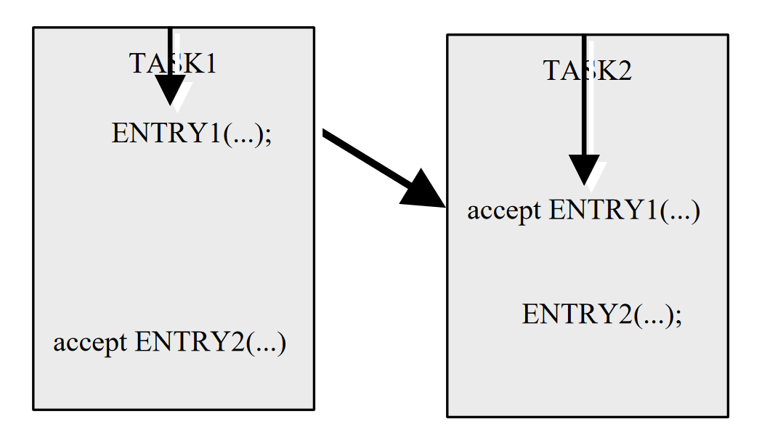

Slide 72
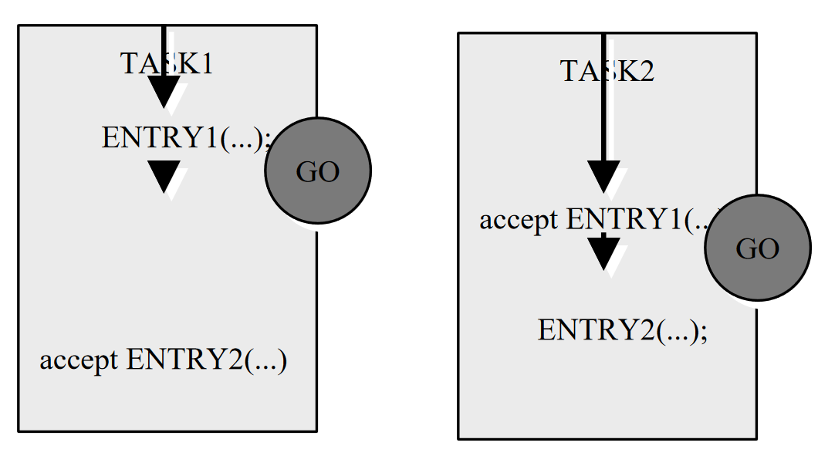

Slide 73
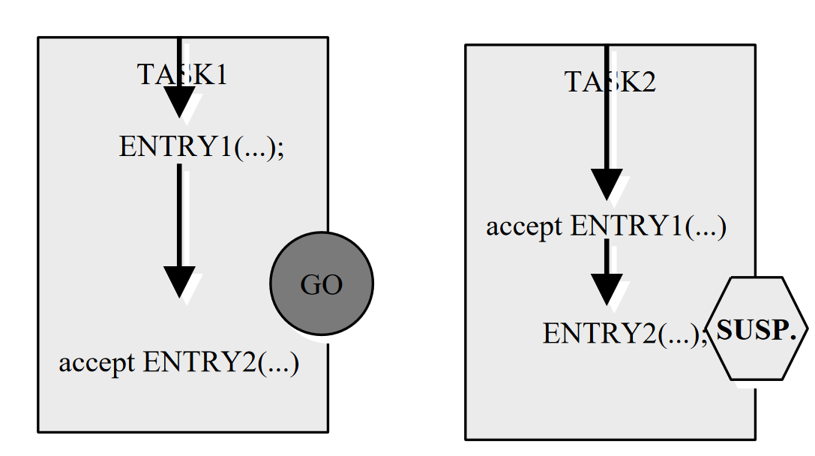

Slide 74
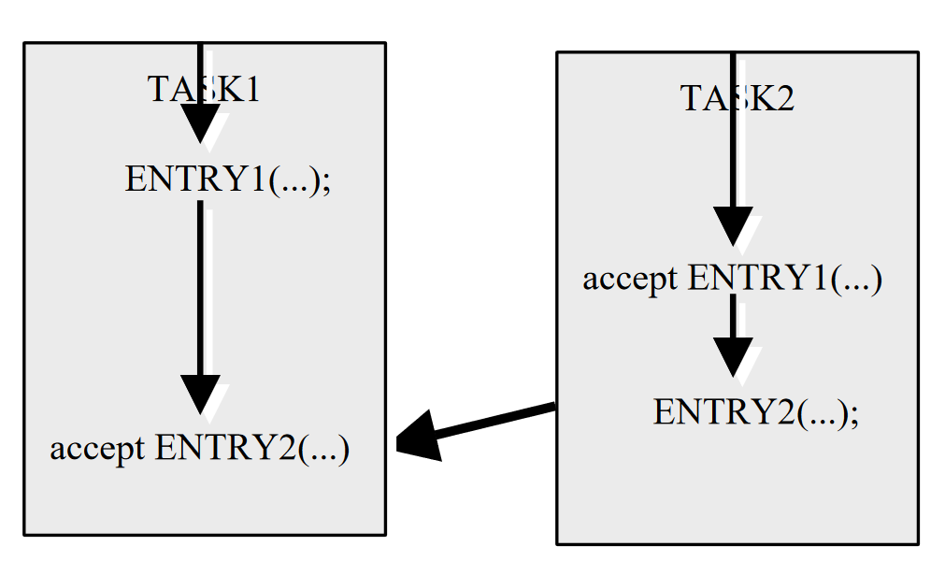

Slide 75
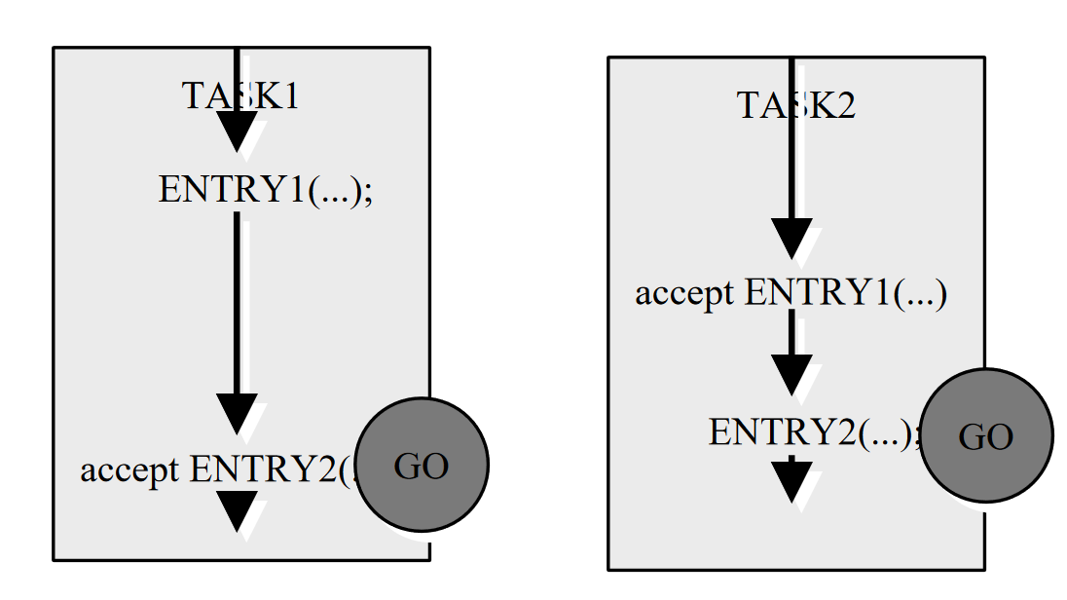

Slide 76
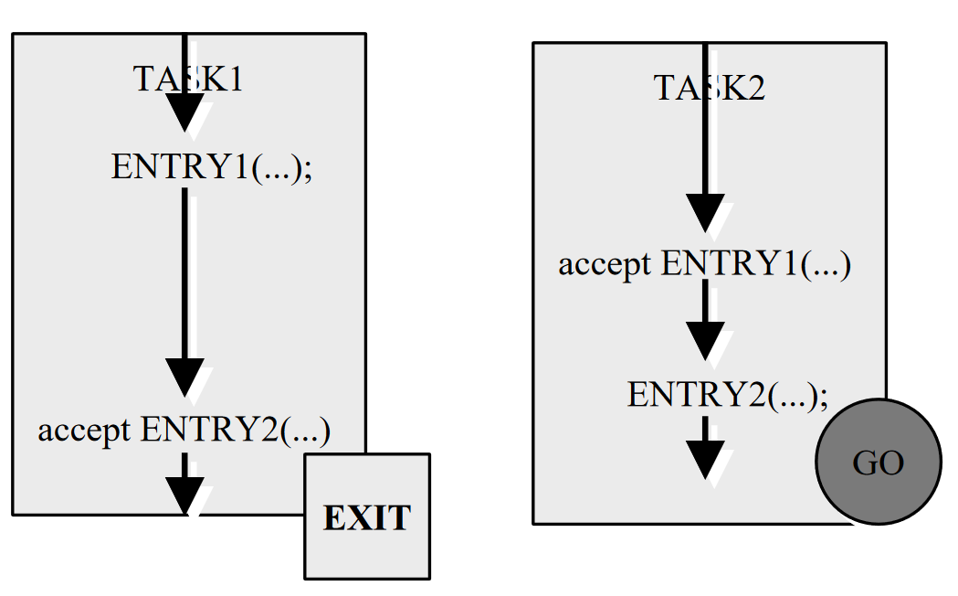

Slide 77
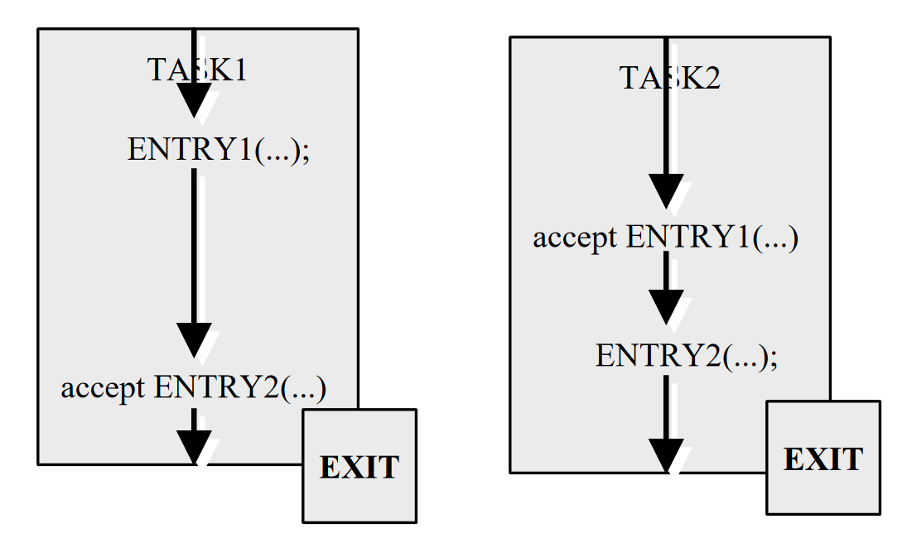

Slide 78
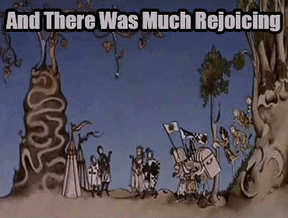
Hooray!

Slide 79
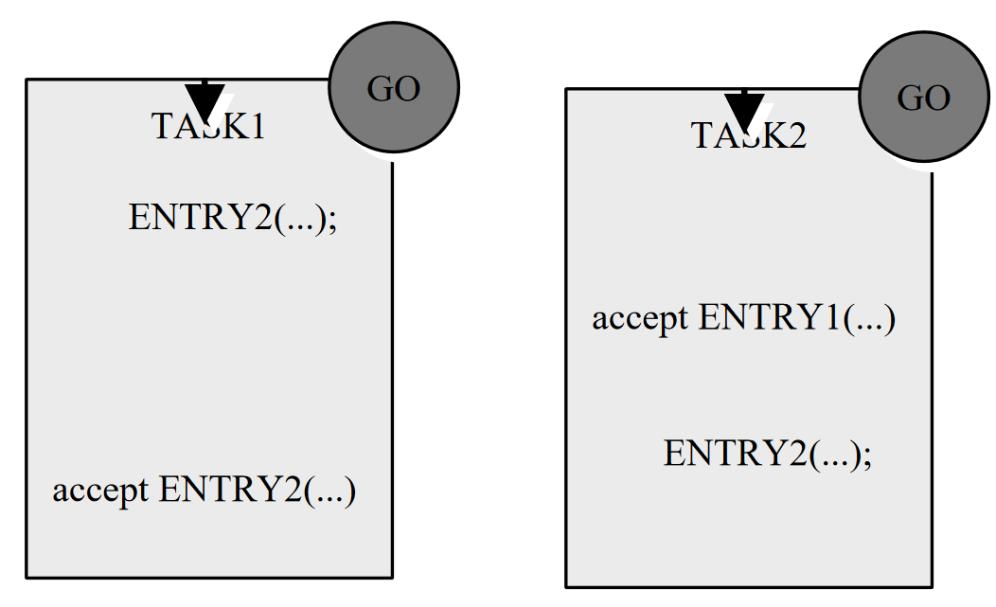
Task Rendezvous Not Working

Slide 80
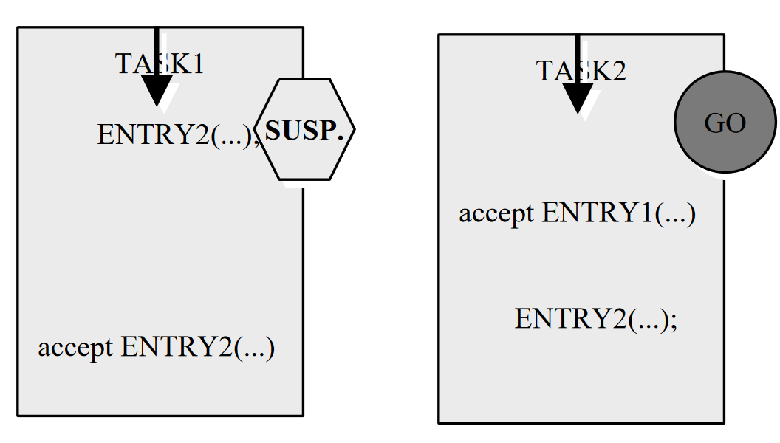

Slide 81
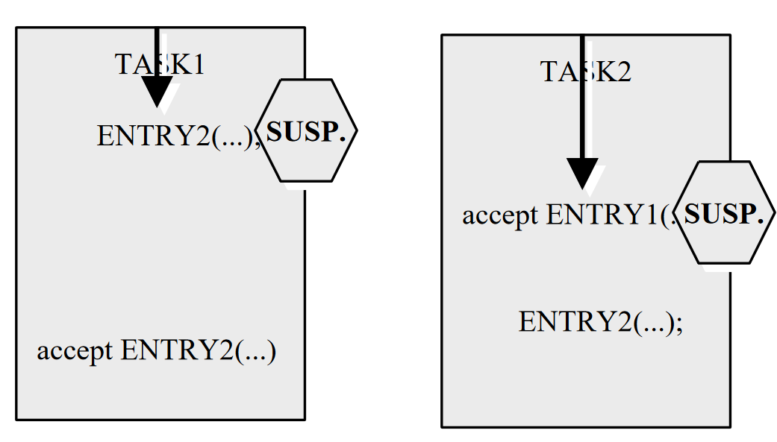
Deadlock!

Slide 82

Deadlock!

Slide 83
Error Handling
Ada has exceptions

Slide 84
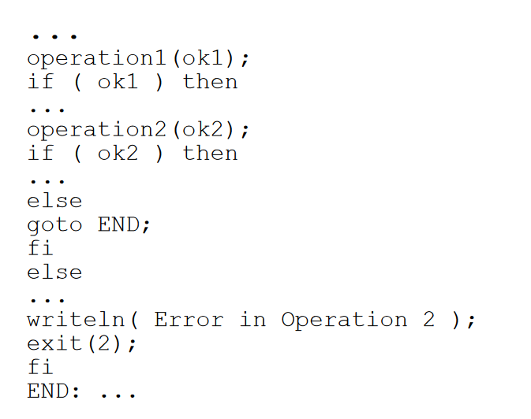
How it worked until Ada

Slide 85
Traditional Errors
Bad things happen, and exceptional events occur during program execution.
These can be error conditions (div by zero), unpredictable conditions (reading EOF), or tracing and monitoring (as in program testing)
When you’re the military, you want your language to handle these. However, until Ada, this was extremely hard.
Div by zero for example halts the program… so unless you catch it before it executes, you’re in trouble.
Traditionally, the only exceptions you had were interrupts.

Slide 86
Interrupts
Two kinds:
Synchronous (caused by your code)
Asynchronous (not caused by your code)
You can only handle synchronous interrupts.
PL/1 was the first to handle these, using the ON condition.
Trap an interrupt, try to solve it.
However, there’s a problem, it’s not easy to determine where in code this came from, as interrupts are system level constructs that the language taps into.
This makes specific case management really hard!

Slide 87
Ada Exceptions
Ada’s exception mechanism is an elaborate internal subsystem that resembles Java’s exception handling mechanism.
The main idea is that any group of statements may have an exception handler for specific exception types.
If the exception can’t be handled locally, it’s handballed up to progressively higher scopes in the dynamic chain.
Ada really defined exception handling that we know today. So in much the same way, exceptions are thrown by code, and caught by handlers.

Slide 88
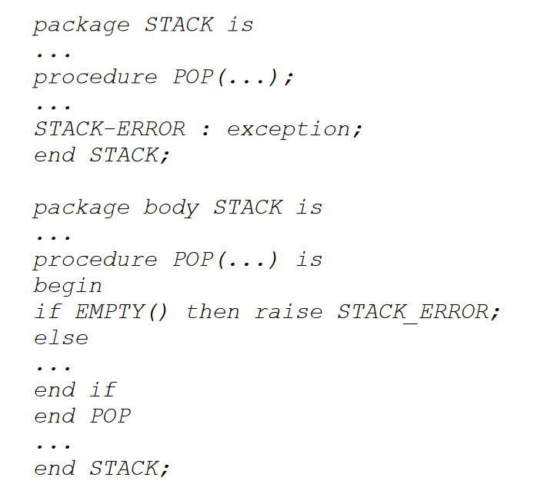
Throwing exceptions

Slide 89
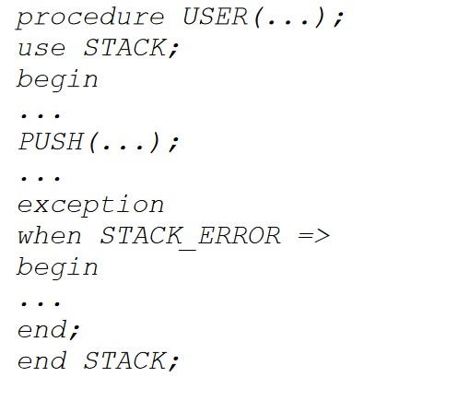
Catching Exceptions

Slide 90
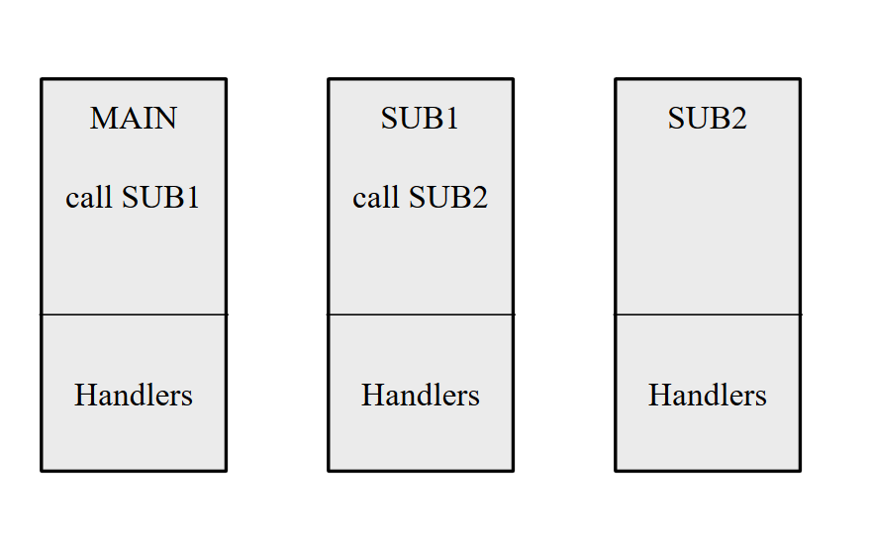
Handler Heirarchy

Slide 91
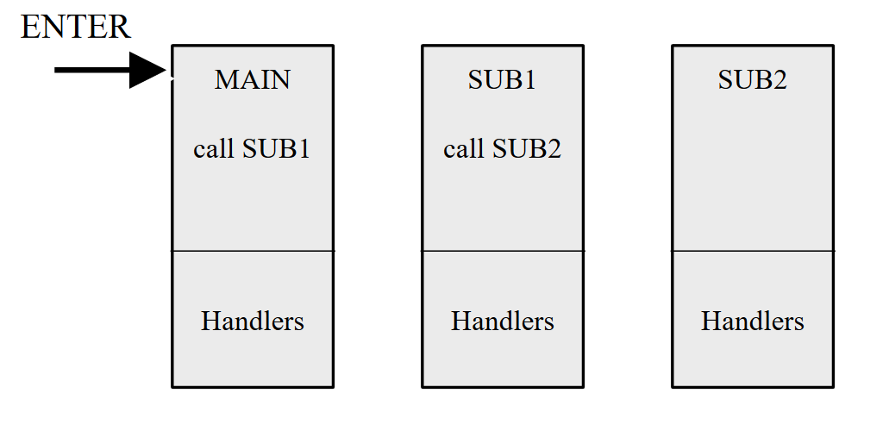

Slide 92
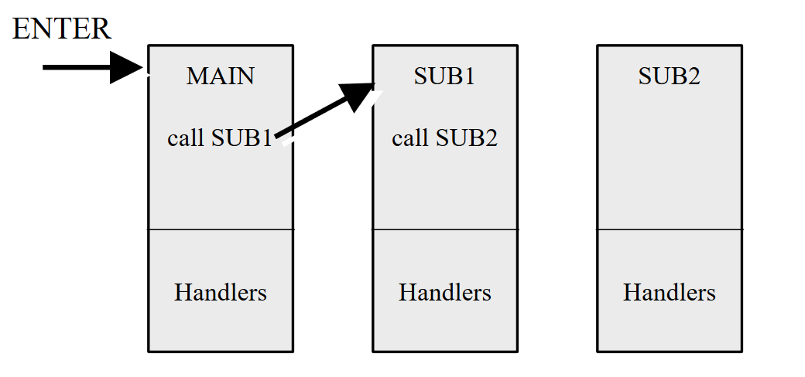

Slide 93
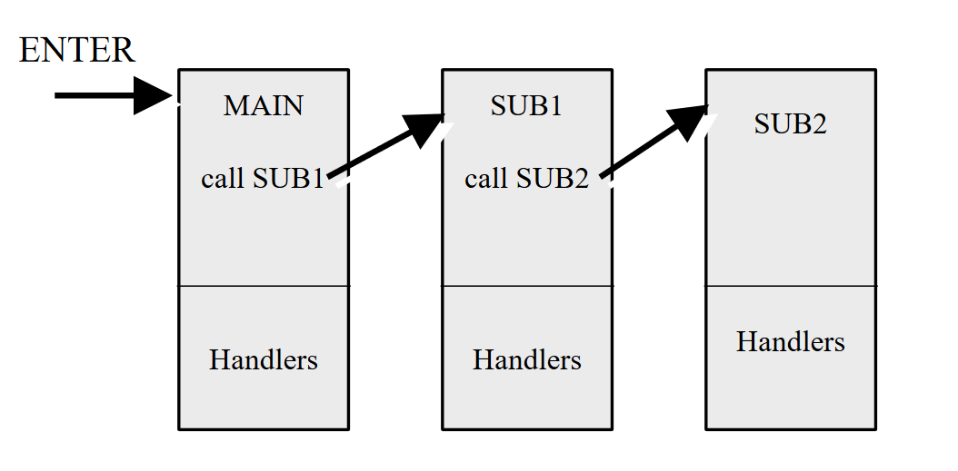

Slide 94
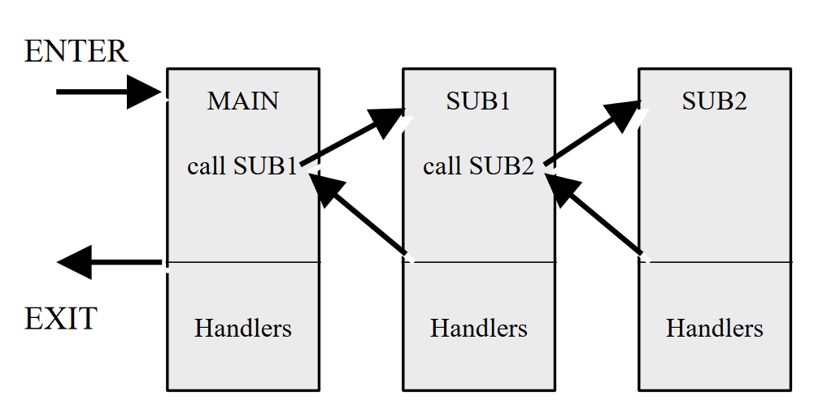

Slide 95
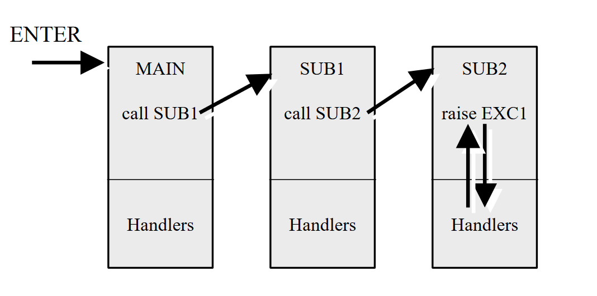

Slide 96
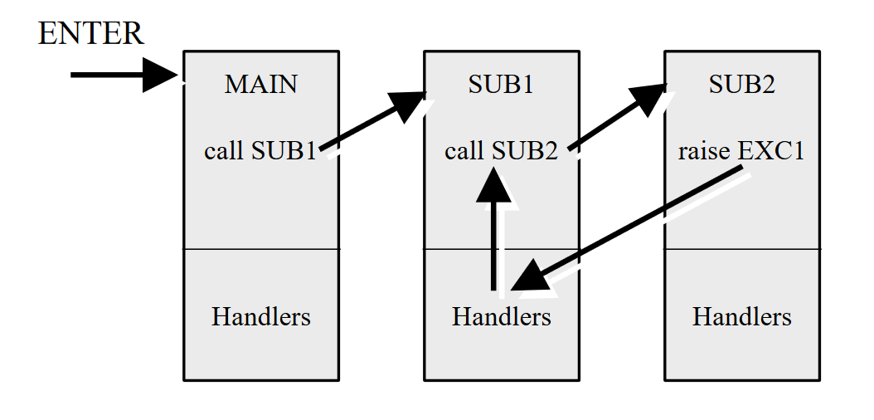

Slide 97
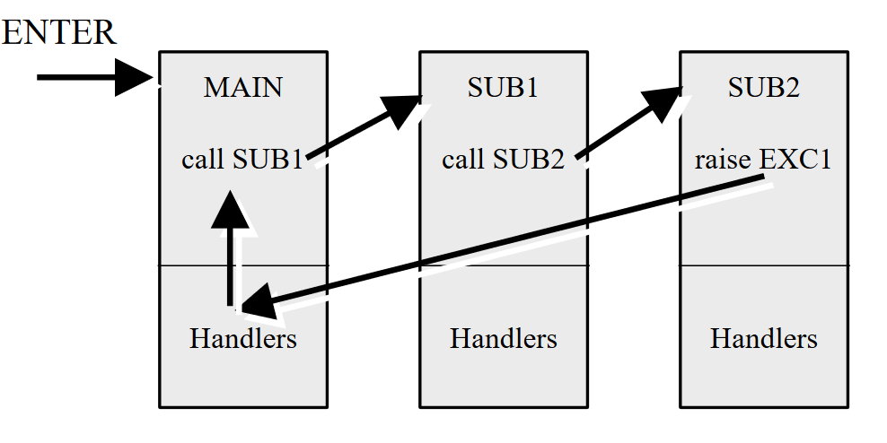

Slide 98
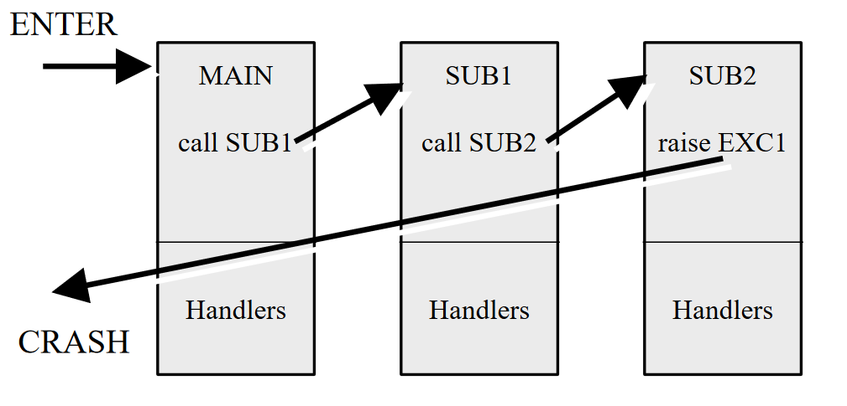

Slide 99
Conclusion
Ada is really complex and long

Slide 100
Ada, a review
Ada is really, really, really complicated, and has been criticised for that.
However, languages like C++ and Java have shown that complicated, modular languages have an important place in the programming world. Sometimes you really need a swiss army knife.
Extremely hard to master Ada, just like C++.
Also just like C++, some have suggested pruning it to make it easier. This did not happen in either case.
Ada may be complicated, but it is regular, modular, and extremely powerful.
Sometimes you need a swiss army knife

Slide 101
So, Ada?
Ada has had a massive impact on programming in the 21st century.
C, C++, Java, Python, Javascript, Objective-C, C#, Go…. So many languages are dependant on the concepts brought about in Ada.
Lady Ada Lovelace was the first programmer,
Ada was the first modern programming language.

Slide 102
BNF
How to write a language

Slide 103
Grammar Definitions
Why should we care about syntactic analysis?
You can provide precise definitions of programming language syntax for the programmers
It also is the basis for syntax analysis in compilers
A formal definition of syntax is a grammar.
A grammar contains a set of definitions which specify the sequence of characters that form allowable statements or programs.
The best known grammar is one of the oldest, the Backus-Naur form, developed primarily by John Backus, one of the FORTRAN developers, for ALGOL.
Noam Chomsky, well known linguist, developed a similar form, the Context Free Grammar.
They’re basically equivalent in power, so, we’ll use BNF.

Slide 104
BNF
BNF is a context free grammar.
Consists of a finite set of BNF grammar rules
Syntax only cares about form, not function. A language is just a set of syntactically correct programs, each being a simple character string.
A syntactically complete program needs not have any meaning! An empty main is still a valid program!
Definition in BNF is simple:
<digit> ::= 0|1|2|3|4|5|6|7|8|9
<> is the category, ::= means “is defined as”, | is or.

Slide 105
BNF
Using basic syntactic categories, more complex languages can be defined.
<conditional_statement> ::= if <Boolean expr> then <statement> else <statement> | if <Boolean expr> then <statement>
Whatever <Boolean expr> and <statement> is must still be defined.
Symbols that are not categories are terminal symbols.

Slide 106
BNF
Recursion allows you to define repetition.
<int> ::= <digit> | <int> <digit>
With formal grammar:
Users can get information about the form of the language
The implementor can use it to build the compiler
It’s basically a meta-language interface!

Slide 107
BNF
Basic function of grammar is to distinguish between syntactically correct and incorrect strings.
If you can parse the string into a tree using the grammar definition, than it must exist in the language, else it must not.
Secondary function is to assign a tree to all strings within the language
Each leaf is a single character or lexical item, each node represents a syntactic category.

Slide 108
EBNF
BNF extended! EBNF
EBNF is awesome because it allows optional terms through the use of square brackets
<int> ::= [+|-]<unsigned int>
Also, you can use braces to define that something can be repeated 0 to many times.
<ident> ::= <letter>{<letter>|<digit>}
Also! You can use round brackets to group statements with the or symbol
<expr> (to|down to) <expr>
Also! You can use the Kleene Cross to describe a thing that repeats one or more times
<unsigned int> ::= <digit>+
Also! You can use the Kleene Star to describe a zero to many recurrence
<ident> ::= <letter>(<letter>|<digit>)*

Slide 109
Grammar, conclusion
Regular grammar → A grammar that can be written in EBNF without any recursion
Context Free Grammar → A grammar that can be written in EBNF and may require recursion.
Most programming languages require recursion
Most programming languages are CFG’s
EBNF is your friend!

